Slide 1
CS4032 Web Programming
Java Script (JS)

Slide 2
Contents
Introduction to JavaScript
JS Design
JS usage
JS Syntax
JS Object
Document Object Model (DOM)
JS Events

Slide 3
What is JavaScript
JavaScript is not JAVA
JavaScript runs right inside the browser
JavaScript is dynamically typed
JavaScript is object oriented in that almost everything in the language is an object
the objects in JavaScript are prototype-based rather than class-based, which means that while JavaScript shares some syntactic features of PHP, Java or C#, it is also quite different from those languages

Slide 4
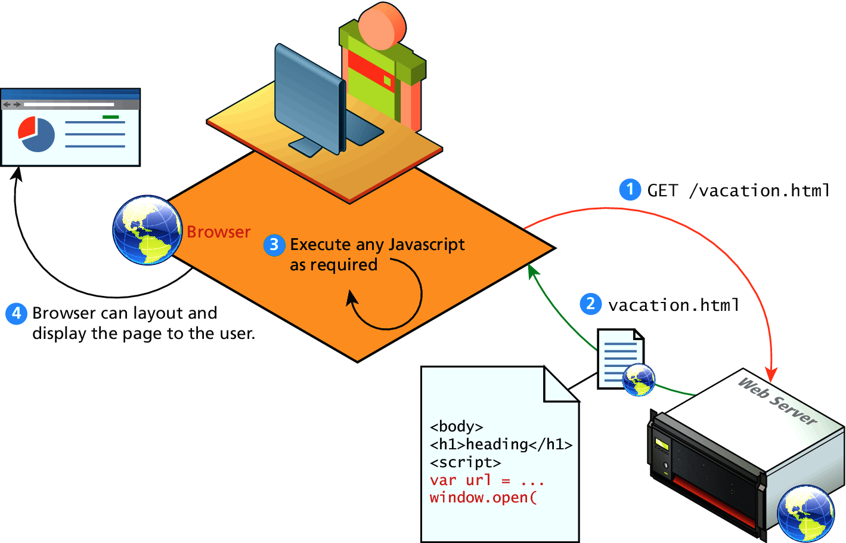
Client-Side Scripting

Slide 5
Client-Side Scripting: Requirements
JavaScript enabled at client side
The idiosyncrasies between various browsers and operating systems that needs a huge testing
JavaScript-heavy web applications can be complicated to debug and maintain.

Slide 6
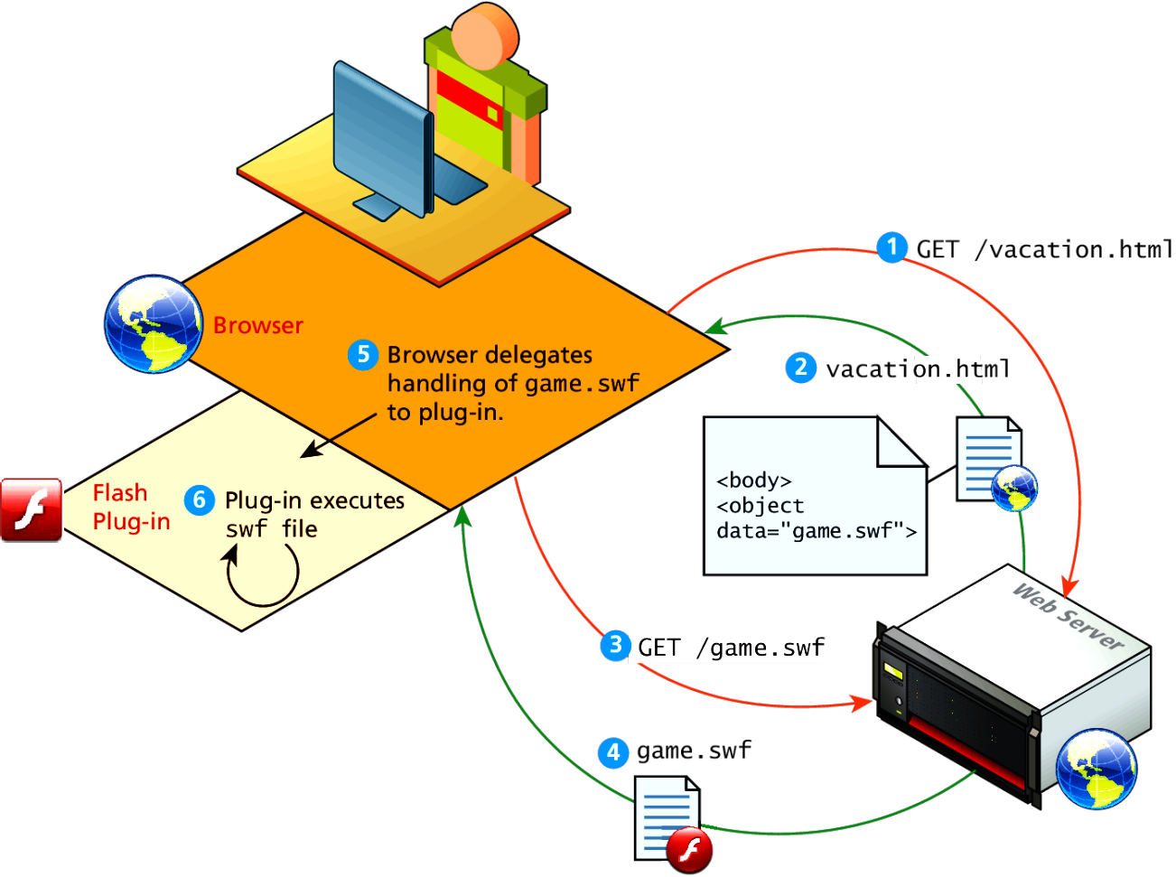
Client-Side Flash
JavaScript is not the only type of client-side scripting.
Browser Plug-ins
Flash

Slide 7
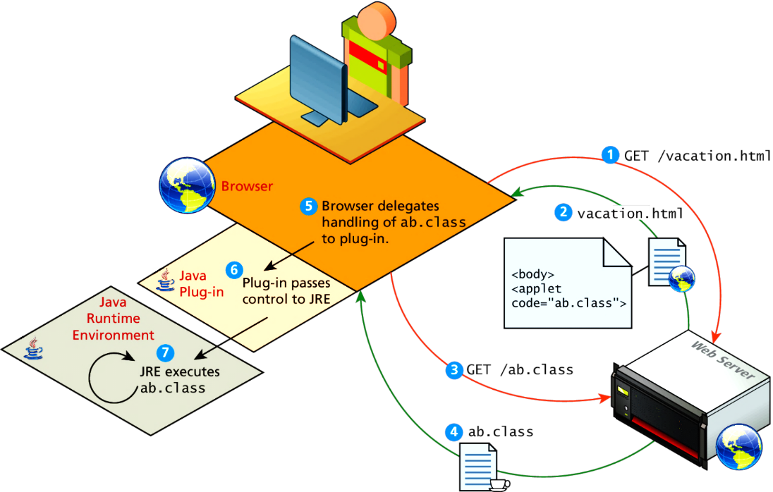
Client-Side Applets
Java Applets
Java applets are written in and are separate objects included within an HTML document via the <applet> tag

Slide 8
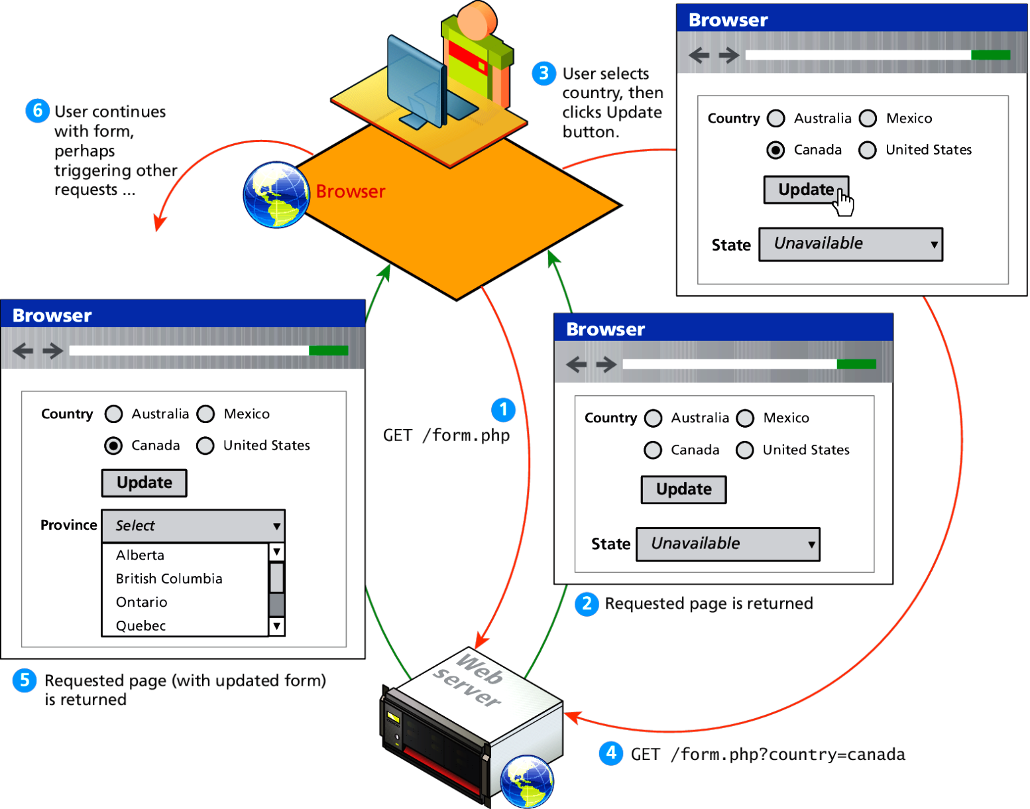
HTTP request response loop

Slide 9
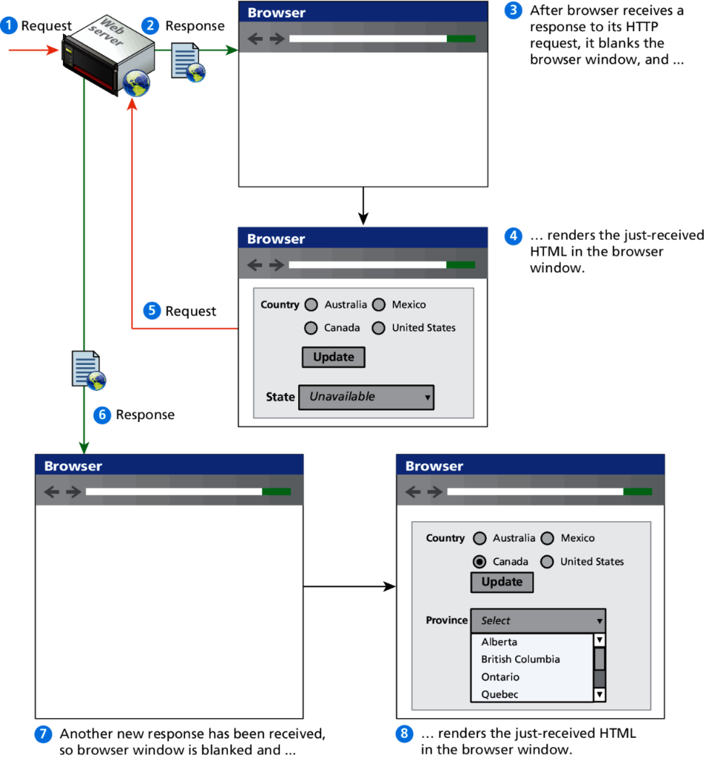
HTTP request response loop

Slide 10
JavaScript in Modern Times
JavaScript became a much more important part of web development in the mid 2000s with AJAX.
AJAX means Asynchronous JavaScript And XML.
The most important feature of AJAX sites is the asynchronous data requests.

Slide 11
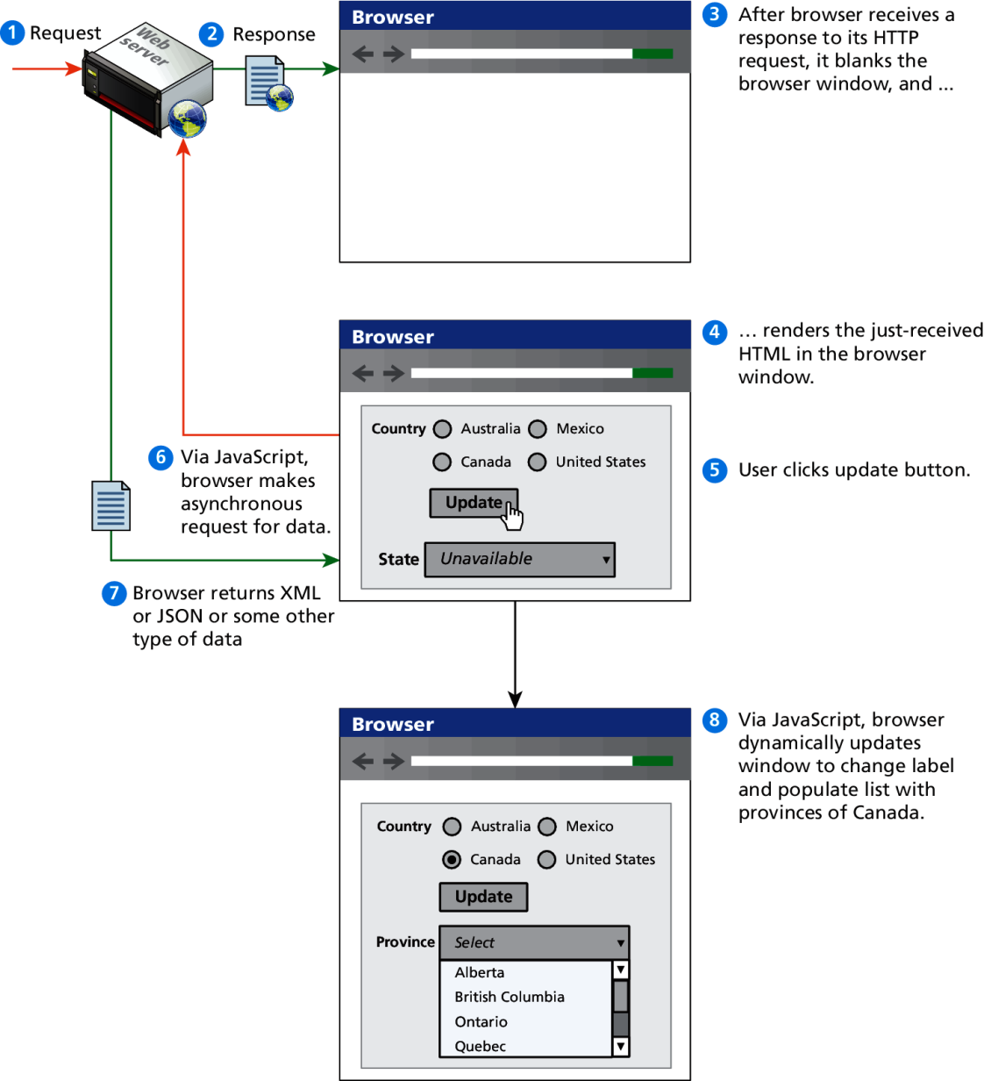
Asynchronous data requests

Slide 12
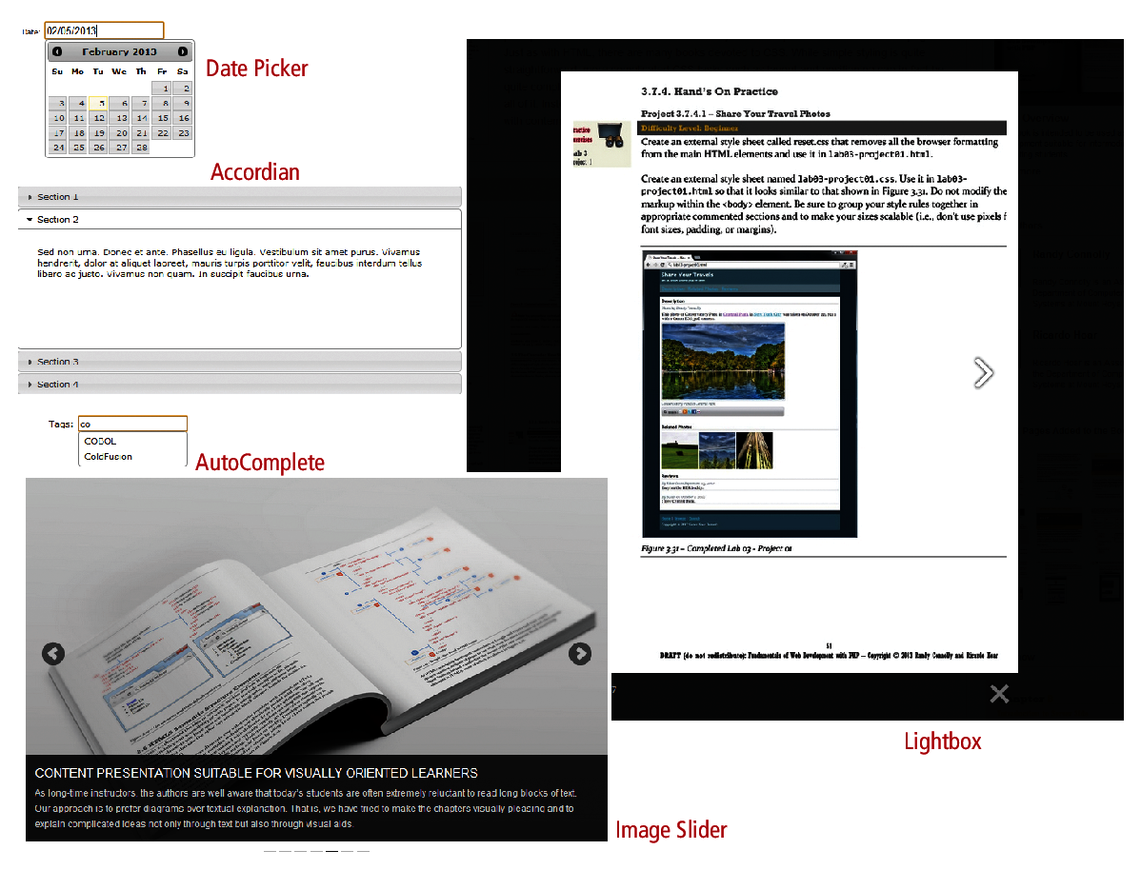
Frameworks

Slide 13
Graceful Degradation and Progressive Enhancement
Over the years, browser support for different JavaScript objects has varied. Something that works in the current version of Chrome might not work in IE version 8; something that works in a desktop browser might not work in a mobile browser.
There are two strategies:
graceful degradation
progressive enhancement

Slide 14
Graceful Degradation

Slide 15
Progressive Enhancement

Slide 16
Where does JavaScript go?
JavaScript can be linked to an HTML page in a number of ways.
Inline
Embedded
External

Slide 17
Inline JavaScript
Inline JavaScript refers to the practice of including JavaScript code directly within certain HTML attributes
Inline JavaScript is a real maintenance nightmare
<a href=“JavaScript:OpenWindow();”>SomeTage</a>
<input type=“submit” onclick=“alert(‘Clicked’);”>

Slide 18
Embedded JavaScript
Embedded JavaScript refers to the practice of placing JavaScript code within a <script> element
<script type=“text/JavaScript”>
alert(‘JS Working’);
</script>

Slide 19
External JavaScript
JavaScript supports this separation by allowing links to an external file that contains the JavaScript.
By convention, JavaScript external files have the extension .js.
<head>
<script type=“text/JavaScript” src=“first.js”>
</script>
</head>

Slide 20
JavaScript Syntax
We will briefly cover the fundamental syntax for the most common programming constructs including
variables
assignment
conditionals
loops
arrays
before moving on to advanced topics such as events and classes.

Slide 21
JavaScript’s Syntax
Everything is type sensitive, including function, class, and variable names.
The scope of variables in blocks is not supported. This means variables declared inside a loop may be accessible outside of the loop, counter to what one would expect.
There is a === operator, which tests not only for equality but type equivalence.
Null and undefined are two distinctly different states for a variable.
Semicolons are not required, but are permitted (and encouraged).
There is no integer type, only number, which means floating-point rounding errors are prevalent

Slide 22
Variables
Variables in JavaScript are dynamically typed, meaning a variable can be an integer, and then later a string, then later an object, if so desired.
This simplifies variable declarations, so that we do not require the familiar type fields like int, char, and String. Instead we use var
Var x; declaration/define
Var y=0; defined and initialized
y=10; assignment
If(y==20){ X=“Y is 20”};
Else {X=“Y is not 20”};
Inline: X=(y==20)? “Y is 20”: “Y is not 20”;

Slide 23
Comparison Operators
Operator | Description | Matches (x=9)
== | Equals | (x==9) is true (x=="9") is true
=== | Exactly equals, including type | (x==="9") is false (x===9) is true
< , > | Less than, Greater Than | (x<5) is false
<= , >= | Less than or equal, greater than or equal | (x<=9) is true
!= | Not equal | (4!=x) is true
!== | Not equal in either value or type | (x!=="9") is true (x!==9) is false

Slide 24
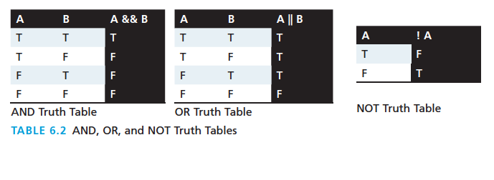
Logical Operators
The Boolean operators and, or, and not and their truth tables are listed in Table 6.2. Syntactically they are represented with && (and), || (or), and ! (not).

Slide 25
Conditionals
JavaScript’s syntax is almost identical to that of PHP, Java, or C when it comes to conditional structures such as if and if else statements. In this syntax the condition to test is contained within ( ) brackets with the body contained in { } blocks.
Var hour;
Var message;
If(hour>4 && hour<12)
message=“Good Morning”;
Else if (hour>=12 && hour<19)
message=“Good Afternoon”;
Else
message=“Good Evening”;

Slide 26
Loops
Like conditionals, loops use the ( ) and { } blocks to define the condition and the body of the loop.
You will encounter the while and for loops
While loops normally initialize a loop control variable before the loop, use it in the condition, and modify it within the loop.
var i=0; // initialise the Loop Control Variable
while(i < 10){ //test the loop control variable
i++; //increment the loop control variable
}

Slide 27
For Loops
A for loop combines the common components of a loop: initialization, condition, and post-loop operation into one statement.
This statement begins with the for keyword and has the components placed between ( ) brackets, semicolon (;) separated as shown
For (var i=0;i<10;i++){
Alert(i)
}

Slide 28
Functions
Functions are the building block for modular code in JavaScript, and are even used to build pseudo-classes, which you will learn about later.
They are defined by using the reserved word function and then the function name and (optional) parameters.
Since JavaScript is dynamically typed, functions do not require a return type, nor do the parameters require type.

Slide 29
Functions
Therefore a function to raise x to the yth power might be defined as:
function power(x,y){
var pow=1;
for (var i=0;i<y;i++){
pow = pow*x;
}
return pow;
}
And called as
power(2,10);

Slide 30
Alert
The alert() function makes the browser show a pop-up to the user, with whatever is passed being the message displayed. The following JavaScript code displays a simple hello world message in a pop-up:
alert ( "Good Morning" );
Using alerts can get tedious fast. When using debugger tools in your browser you can write output to a log with:
console.log("Put Messages Here");
And then use the debugger to access those logs.

Slide 31
Errors using try and catch
When the browser’s JavaScript engine encounters an error, it will throw an exception. These exceptions interrupt the regular, sequential execution of the program and can stop the JavaScript engine altogether. However, you can optionally catch these errors preventing disruption of the program using the try–catch block
Try{
Function_not_found(“test”);
}
Catch(err1){
Alert(“Exception details:”+err1);
}

Slide 32
Throw your own
Although try-catch can be used exclusively to catch built-in JavaScript errors, it can also be used by your programs, to throw your own messages. The throw keyword stops normal sequential execution, just like the built-in exceptions
Try{
Var x=1
If(x%2==1){
Throw “Exception1”;
}
}
Catch(excpt){
Alert(excpt+”Custom except”)
}

Slide 33
Tips
Try-catch and throw statements should be used for abnormal or exceptional cases in your program.
Throwing an exception disrupts the sequential execution of a program. When the exception is thrown all subsequent code is not executed until the catch statement is reached.
This reinforces why try-catch is for exceptional cases.

Slide 34
JavaScript Objects
JavaScript is not a full-fledged object-oriented programming language.
It does not have classes per se, and it does not support many of the patterns you’d expect from an object-oriented language like inheritance and polymorphism.
The language does, however, support objects.

Slide 35
JavaScript Objects
Objects can have constructors, properties, and methods associated with them.
There are objects that are included in the JavaScript language; you can also define your own kind of objects.

Slide 36
Constructors
Normally to create a new object we use the new keyword, the class name, and ( ) brackets with n optional parameters inside, comma delimited as follows:
var someObject = new ObjectName(p1,p2,..., pn);
For some classes, shortcut constructors are defined
var greetings = new String("Good Morning");

Slide 37
Properties
Each object might have properties that can be accessed, depending on its definition.
When a property exists, it can be accessed using dot notation where a dot between the instance name and the property references that property.
//show someObject.property to the user alert(someObject.property);

Slide 38
Methods
Objects can also have methods, which are functions associated with an instance of an object. These methods are called using the same dot notation as for properties, but instead of accessing a variable, we are calling a method.
someObject.doSomething();
Methods may produce different output depending on the object they are associated with because they can utilize the internal properties of the object.

Slide 39
Objects Included in JavaScript
A number of useful objects are included with JavaScript including:
Array
Boolean
Date
Math
String
Dom objects

Slide 40
Arrays
Arrays are one of the most used data structures. In practice, this class is defined to behave more like a linked list in that it can be resized dynamically, but the implementation is browser specific, meaning the efficiency of insert and delete operations is unknown.
The following code creates a new, empty array named greetings:
var greetings = new Array();

Slide 41
Arrays
To initialize the array with values, the variable declaration would look like the following:
var greetings = new Array("Good Morning", "Good Afternoon");
or, using the square bracket notation:
var greetings = ["Good Morning", "Good Afternoon"];

Slide 42
Arrays
To access an element in the array you use the familiar square bracket notation from Java and C-style languages, with the index you wish to access inside the brackets.
alert ( greetings[0] );
One of the most common actions on an array is to traverse through the items sequentially. Using the Array object’s length property to determine the maximum valid index. We have:
for (var i = 0; i < greetings.length; i++){
alert(greetings[i]);
}

Slide 43
Arrays
To add an item to an existing array, you can use the push method.
greetings.push("Good Evening");
The pop method can be used to remove an item from the back of an array.
Additional methods: concat(), slice(), join(), reverse(), shift(), and sort()

Slide 44
Math
The Math class allows one to access common mathematic functions and common values quickly in one place.
This static class contains methods such as max(), min(), pow(), sqrt(), and exp(), and trigonometric functions such as sin(), cos(), and arctan().
Many mathematical constants are defined such as PI, E, SQRT2, and some others
Math.PI; // 3.141592657
Math.sqrt(4); // square root of 4 is 2.
Math.random(); // random number between 0 and 1

Slide 45
String
The String class has already been used without us even knowing it.
Constructor usage
var greet = new String("Good"); // long form constructor
var greet = "Good"; // shortcut constructor
Length of a string
alert (greet.length); // will display "4"

Slide 46
String
var str = greet.concat("Morning"); // Long form concatenation
var str = greet + "Morning"; // + operator concatenation
Many other useful methods exist within the String class, such as
accessing a single character using charAt()
searching for one using indexOf().
Strings allow splitting a string into an array, searching and matching with split(), search(), and match() methods.

Slide 47
Date
The Date class is yet another helpful included object you should be aware of. It allows you to quickly calculate the current date or create date objects for particular dates. To display today’s date as a string, we would simply create a new object and use the toString() method.
var d = new Date();
// This outputs Today is Mon Nov 12 2012 15:40:19 GMT-0700
alert ("Today is "+ d.toString());

Slide 48
Window
The window object in JavaScript corresponds to the browser itself. Through it, you can access the current page’s URL, the browser’s history, and what’s being displayed in the status bar, as well as opening new browser windows.
In fact, the alert() function mentioned earlier is actually a method of the window object.

Slide 49
The DOM
JavaScript is almost always used to interact with the HTML document in which it is contained.
This is accomplished through a programming interface (API) called the Document Object Model.
According to the W3C, the DOM is a:
Platform- and language-neutral interface that will allow programs and scripts to dynamically access and update the content, structure and style of documents.

Slide 50
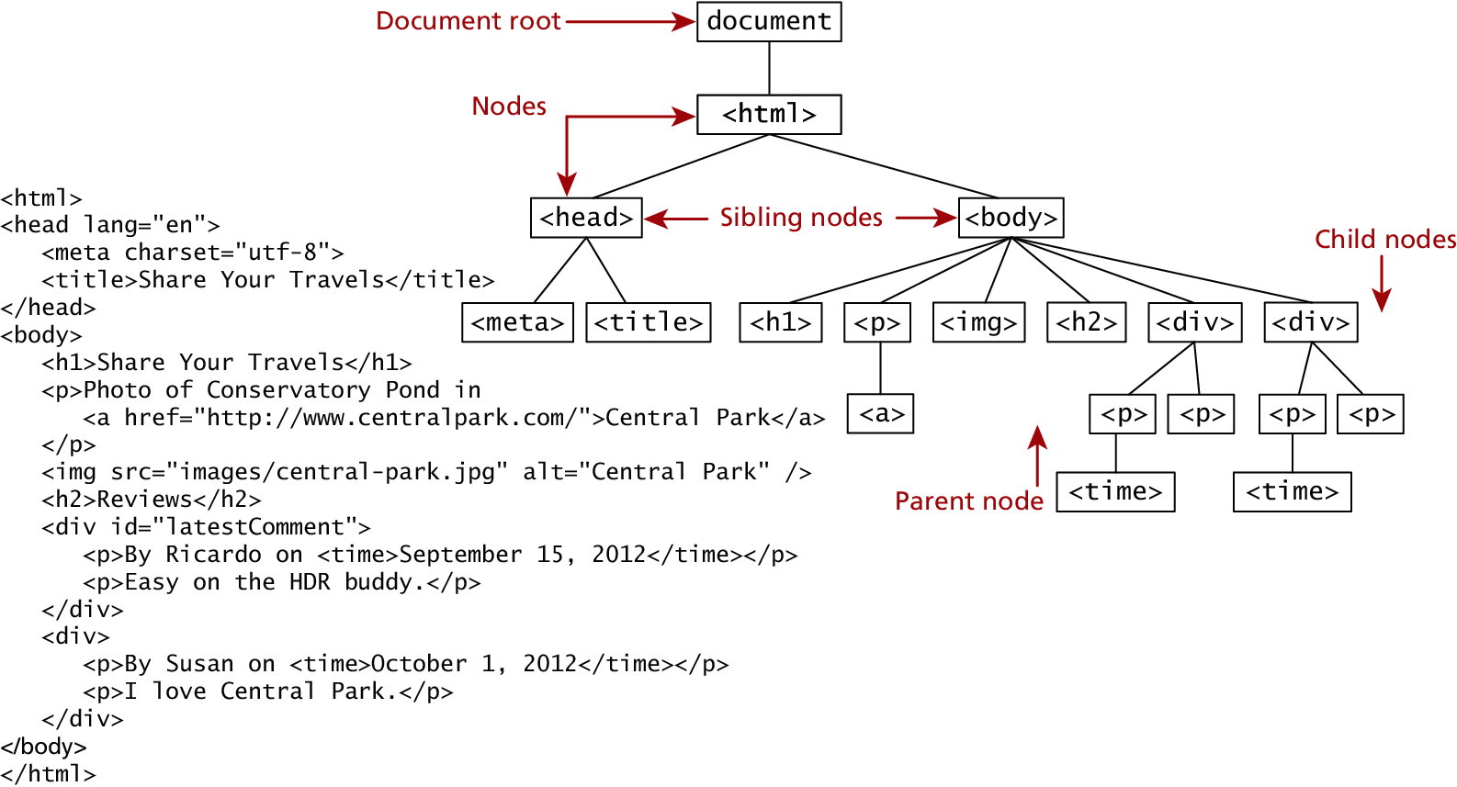
The DOM
We already know all about the DOM, but by another name. The tree structure from Chapter 2 (HTML) is formally called the DOM Tree with the root, or topmost object called the Document Root.

Slide 51
DOM Nodes
In the DOM, each element within the HTML document is called a node. If the DOM is a tree, then each node is an individual branch.
There are:
element nodes,
text nodes
attribute nodes
All nodes in the DOM share a common set of properties and methods.

Slide 52
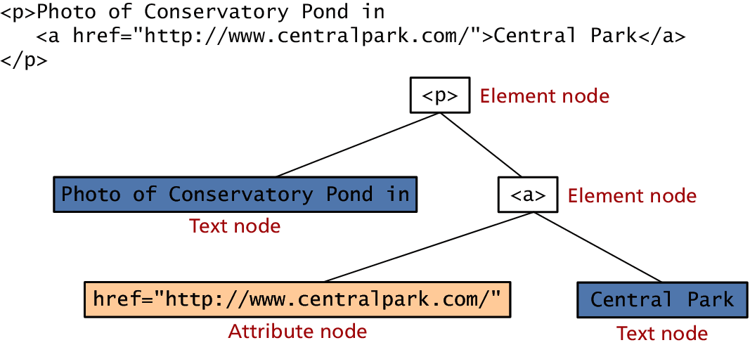
DOM Nodes

Slide 53
DOM Nodes
Property | Description
attributes | Collection of node attributes
childNodes | A NodeList of child nodes for this node
firstChild | First child node of this node.
lastChild | Last child of this node.
nextSibling | Next sibling node for this node.
nodeName | Name of the node
nodeType | Type of the node
nodeValue | Value of the node
parentNode | Parent node for this node.
previousSibling | Previous sibling node for this node.

Slide 54
Document Object
The DOM document object is the root JavaScript object representing the entire HTML document.
It contains some properties and methods that we will use extensively in our development and is globally accessible as document.
// specify the doctype, for example html
var a = document.doctype.name;
// specify the page encoding, for example ISO-8859-1
var b = document.inputEncoding;

Slide 55
Document Object
Method | Description
createAttribute() | Creates an attribute node
createElement() | Creates an element node
createTextNode() | Create a text node
getElementById(id) | Returns the element node whose id attribute matches the passed id parameter.
getElementsByTagName(name) | Returns a nodeList of elements whose tag name matches the passed name parameter.

Slide 56
Create Element
// Create a <button> element
var btn = document.createElement("BUTTON");
// Create a text node
var t = document.createTextNode("CLICK ME");
// Append the text to <button>
btn.appendChild(t);
// Append <button> to <body>
document.body.appendChild(btn);

Slide 57
Create Attribute
// Get the first <h1> element in the document
var h1 = document.getElementsByTagName("H1")[0];
// Create a "class" attribute
var att = document.createAttribute("class");
// Set the value of the class attribute
att.value = "democlass";
Assignment
h1.setAttributeNode(att);

Slide 58
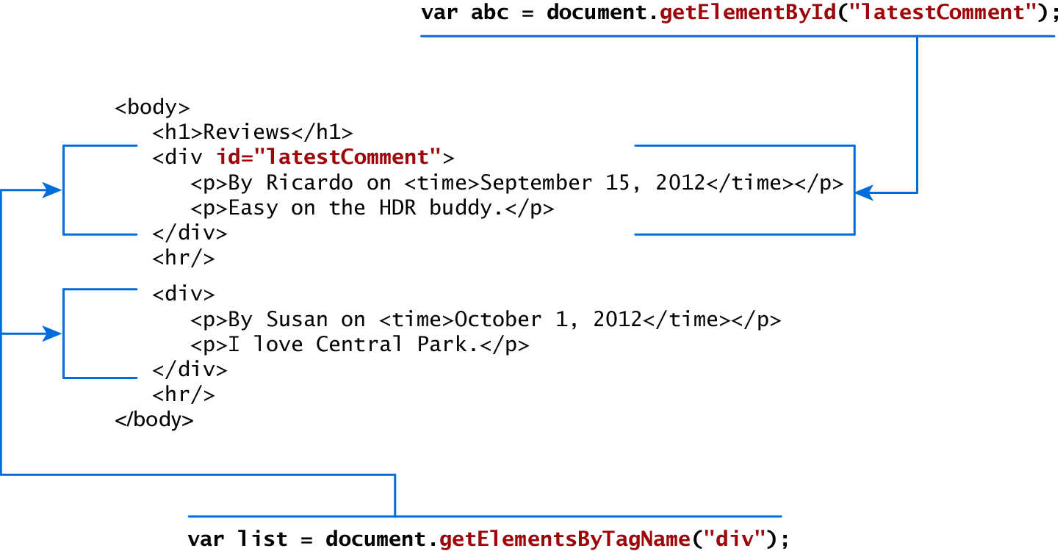
Accessing nodes

Slide 59
Element node Object
The type of object returned by the method document.getElementById() described in the previous section is an element node object.
This represents an HTML element in the hierarchy, contained between the opening <> and closing </> tags for this element.
can itself contain more elements

Slide 60
Element node Object
Property | Description
className | The current value for the class attribute of this HTML element.
id | The current value for the id of this element.
innerHTML | Represents all the things inside of the tags. This can be read or written to and is the primary way which we update particular div's using JS.
style | The style attribute of an element. We can read and modify this property.
tagName | The tag name for the element.

Slide 61
Modifying a DOM element
The document.write() method is used to create output to the HTML page from JavaScript. The modern JavaScript programmer will want to write to the HTML page, but in a particular location, not always at the bottom
Using the DOM document and HTML DOM element objects, we can do exactly that using the innerHTML property
Var latest = document.getElementById(“latestComment”);
Var oldMessage = latest.innerHTML;
Latest.innerHTML = oldMessage + “<p>Updated this div with JS</p>”;

Slide 62
Modifying a DOM element
Although the innerHTML technique works well (and is very fast), there is a more verbose technique available to us that builds output using the DOM.
DOM functions createTextNode(), removeChild(), and appendChild() allow us to modify an element in a more rigorous way
Var latest=document.getElementById(“latest Comment”);
Var oldMessage = latest.innerHTML;
Var newMessage = oldMessage+”<p>Updated this div with JS</p>”;
Latest.removeChild(latest.firstChild);
Latest.appendChild(document.createTextNode(newMessage));

Slide 63
Changing an element’s style
We can add or remove any style using the style or className property of the Element node.
Its usage is shown below to change a node’s background color and add a three-pixel border.
var commentTag = document.getElementById("specificTag");
commentTag.style.backgroundColour = "#FFFF00";
commentTag.style.borderWidth="3px";

Slide 64
Changing an element’s style
The className property is normally a better choice, because it allows the styles to be created outside the code, and thus be better accessible to designers.
var commentTag = document.getElementById("specificTag");
commentTag.className = "someClassName";
HTML5 introduces the classList element, which allows you to add, remove, or toggle a CSS class on an element.
label.classList.addClass("someClassName");

Slide 65
More Properties
Property | Description | Tags
href | The href attribute used in a tags to specify a URL to link to. | a
name | The name property is a bookmark to identify this tag. Unlike id which is available to all tags, name is limited to certain form related tags. | a, input, textarea, form
src | Links to an external URL that should be loaded into the page (as opposed to href which is a link to follow when clicked) | img, input, iframe, script
value | The value is related tot he value attribute of input tags. Often the value of an input field is user defined, and we use value to get that user input. | Input, textarea, submit

Slide 66
JavaScript Events
A JavaScript event is an action that can be detected by JavaScript.
We say then that an event is triggered and then it can be caught by JavaScript functions, which then do something in response.

Slide 67
JavaScript Events
In the original JavaScript world, events could be specified right in the HTML markup with hooks to the JavaScript code (and still can).
As more powerful frameworks were developed, and website design and best practices were refined, this original mechanism was supplanted by the listener approach.

Slide 68
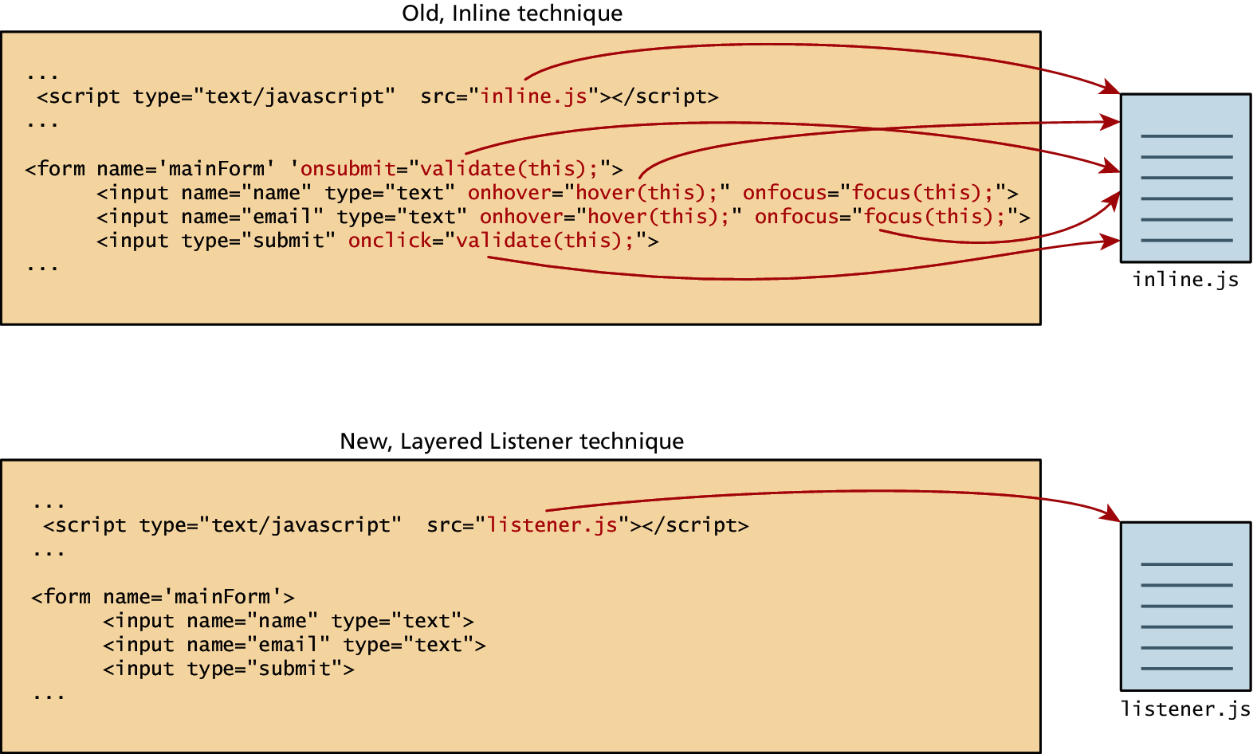
JavaScript Events

Slide 69
Inline Event Handler Approach
For example, if you wanted an alert to pop-up when clicking a <div> you might program:
<div id="example1" onclick="alert('hello')">Click for pop-up</div>
The problem with this type of programming is that the HTML markup and the corresponding JavaScript logic are woven together. It does not make use of layers; that is, it does not separate content from behavior.

Slide 70
Event Object
No matter which type of event we encounter, they are all DOM event objects and the event handlers associated with them can access and manipulate them. Typically we see the events passed to the function handler as a parameter named e.
function someHandler(e) {
// e is the event that triggered this handler.
}

Slide 71
Event Types
There are several classes of event, with several types of event within each class specified by the W3C:
mouse events
keyboard events
form events
frame events

Slide 72
Mouse events
Event | Description
onclick | The mouse was clicked on an element
ondblclick | The mouse was double clicked on an element
onmousedown | The mouse was pressed down over an element
onmouseup | The mouse was released over an element
onmouseover | The mouse was moved (not clicked) over an element
onmouseout | The mouse was moved off of an element
onmousemove | The mouse was moved while over an element

Slide 73
Keyboard events
Event | Description
onkeydown | The user is pressing a key (this happens first)
onkeypress | The user presses a key (this happens after onkeydown)
onkeyup | The user releases a key that was down (this happens last)

Slide 74
Keyboard events
<input type="text" id="keyExample">
The input box above, for example, could be listened to and each key pressed echoed back to the user as an alert as shown in Listing 6.15.
Document.getElementById(“keyExample”).onkeydown= function myFunction(e){
Var keyPressed=e.keyCode;
Var characher=String.fromCharCode(keyPressed);
Alert(“Key ”+character+”was pressed”);
}

Slide 75
Form Events
Event | Description
onblur | A form element has lost focus (that is, control has moved to a different element, perhaps due to a click or Tab key press.
onchange | Some <input>, <textarea> or <select> field had their value change. This could mean the user typed something, or selected a new choice.
onfocus | Complementing the onblur event, this is triggered when an element gets focus (the user clicks in the field or tabs to it)
onreset | HTML forms have the ability to be reset. This event is triggered when that happens.
onselect | When the users selects some text. This is often used to try and prevent copy/paste.
onsubmit | When the form is submitted this event is triggered. We can do some pre-validation when the user submits the form in JavaScript before sending the data on to the server.

Slide 76
Form Events
Document.getElementById(“form1”).onsubmit=function(e){
Var user=document.getElementById(“user”).value;
If(user==“”){
Alert(“Provide username”);
E.preventDefault();
}
}

Slide 77
Frame Events
Frame events are the events related to the browser frame that contains your web page.
The most important event is the onload event, which tells us an object is loaded and therefore ready to work with. If the code attempts to set up a listener on this not-yet-loaded <div>, then an error will be triggered.
window.onload= function(){
//all JavaScript initialization here.
}

Slide 78
Validating Forms
Writing code to prevalidate forms on the client side will reduce the number of incorrect submissions, thereby reducing server load.
There are a number of common validation activities including email validation, number validation, and data validation.

Slide 79
Validating Forms
Document.getElementById(“form1”).onsubmit=function(e){
Var user=document.getElementById(“user”).value;
If(user==“”){
Alert(“Provide username”);
E.preventDefault();
}
}

Slide 80
Validating Forms
If you want to ensure a checkbox is ticked, use code like that below.
var inputField=document.getElementByID("license");
if (inputField.type=="checkbox"){
if (inputField.checked)
//Now we know the box is checked
}

Slide 81
Validating Forms
Function isNumber(n){
return !isNaN(parseFloat(n)) && isFinite(n);
}

Slide 82
Submitting Forms
Submitting a form using JavaScript requires having a node variable for the form element. Once the variable, say, formExample is acquired, one can simply call the submit() method:
var formExample = document.getElementById("loginForm");
formExample.submit();

